Slide 1
Cryptography and Network Security Chapter 13
Fourth Edition
by William Stallings
Lecture slides by Lawrie Brown
Notes:
Lecture slides by Lawrie Brown for “Cryptography and Network Security”, 4/e, by William Stallings, Chapter 13 – “Digital Signatures & Authentication Protocols”.

Slide 2
Chapter 13 – Digital Signatures & Authentication Protocols
Notes:
Opening quote.

Slide 3
Digital Signatures
digital signatures provide the ability to:
verify author, date & time of signature
authenticate message contents
It cab be verified by third parties to resolve disputes
Notes:
The most important development from the work on public-key cryptography is the digital signature. Message authentication protects two parties who exchange messages from any third party. However, it does not protect the two parties against each other. A digital signature is analogous to the handwritten signature, and provides a set of security capabilities that would be difficult to implement in any other way. It must have the following properties:
• It must verify the author and the date and time of the signature
• It must to authenticate the contents at the time of the signature
• It must be verifiable by third parties,to resolve disputes
Thus, the digital signature function includes the authentication function.

Slide 4
Digital Signature Properties
must depend on the message signed
must use information unique to sender
to prevent both forgery and denial
Must be easy to produce DS
Must be easy to recognize & verify DS
Must be computationally infeasible to forge
with new message for existing digital signature
with fraudulent digital signature for given message
Must be easy to store digital signature
Notes:
On the basis of the properties on the previous slide, we can formulate the requirements for a digital signature as shown. A variety of approaches has been proposed for the digital signature function. These approaches fall into two categories: direct and arbitrated.

Slide 5
Direct Digital Signature
It involves only sender & receiver
Sender creates digital signature by signing entire message or hash value of message with his private-key
Note: sign first; then encrypt message & signature
Notes:
Direct Digital Signatures involve the direct application of public-key algorithms involving only the communicating parties. A digital signature may be formed by encrypting the entire message with the sender’s private key, or by encrypting a hash code of the message with the sender’s private key. Confidentiality can be provided by further encrypting the entire message plus signature using either public or private key schemes. It is important to perform the signature function first and then an outer confidentiality function, since in case of dispute, some third party must view the message and its signature. But these approaches are dependent on the security of the sender’s private-key. Will have problems if it is lost/stolen and signatures forged. Need time-stamps and timely key revocation.

Slide 6
Arbitrated Digital Signature
It involves an arbiter A who
validates any signed message
then message is dated and sent to recipient
requires that arbiter to be trusted person
can be implemented with either secret key or public-key algorithms
arbiter may or may not see message
Notes:
The problems associated with direct digital signatures can be addressed by using an arbiter, in a variety of possible arrangements, as shown in Stallings Table 13.1.
The arbiter plays a sensitive and crucial role in this sort of scheme, and all parties must have a great deal of trust that the arbitration mechanism is working properly.
These schemes can be implemented with either private or public-key algorithms, and the arbiter may or may not see the actual message contents.

Slide 7
Authentication Protocols
used to convince identity of one party to another party and to exchange session keys
may be one-way authentication or mutual authentication
key issues are
confidentiality – to protect session keys
timeliness – to prevent replay attacks
Notes:
Authentication Protocols are used to convince parties of each others identity and to exchange session keys. They may be one-way or mutual.
Central to the problem of authenticated key exchange are two issues: confidentiality and timeliness. To prevent masquerade and to prevent compromise of session keys, essential identification and session key information must be communicated in encrypted form. This requires the prior existence of secret or public keys that can be used for this purpose. The second issue, timeliness, is important because of the threat of message replays.
Stallings discusses a number of protocols that appeared secure but were revised after additional analysis. These examples highlight the difficulty of getting things right in the area of authentication.

Slide 8
Replay Attacks
where a valid signed message M is copied and resent later
simple replay – copy M & resend later
repetition that can be logged – replay time stamped M within valid time window
repetition that cannot be detected – Suppress the original message and only replay message arrives (delay)
suppress replay attack- Uses wrong clocks(slow / fast)
backward replay without modification – replay M back to sender – possible if symmetric encryption is used.
countermeasures include
use of sequence numbers (generally impractical)
timestamps (needs synchronized clocks)
challenge/response (using unique nonce)
Notes:
Replay Attacks are where a valid signed message is copied and later resent. Such replays, at worst, could allow an opponent to compromise a session key or successfully impersonate another party. At minimum, a successful replay can disrupt operations by presenting parties with messages that appear genuine but are not.
[GONG93] lists the examples above of replay attacks.
Possible countermeasures include the use of:
• sequence numbers (generally impractical since must remember last number used with every communicating party)
• timestamps (needs synchronized clocks amongst all parties involved, which can be problematic)
• challenge/response (using unique, random, unpredictable nonce, but not suitable for connectionless applications because of handshake overhead)

Slide 9
Using Symmetric Encryption
trusted Key Distribution Center (KDC) is used
each party shares his own master key with KDC
KDC generates session keys
master keys used to distribute session keys to communication parties
Notes:
A two-level hierarchy of symmetric encryption keys can be used to provide confidentiality for communication in a distributed environment.
Usually involves the use of a trusted key distribution center (KDC). Each party in the network shares a secret master key with the KDC. The KDC is responsible for generating session keys, and for distributing those keys to the parties involved, using the master keys to protect these session keys.

Slide 10
Needham-Schroeder Protocol
This is first key distribution protocol using third party KDC
protocol overview is:
1. A->KDC: ID_{A} || ID_{B} || N₁
2. KDC -> A: E_{Ka}[Ks || ID_{B} || N₁ || E_{Kb}[Ks||ID_{A}] ]
3. A -> B: E_{Kb}[Ks||ID_{A}]
4. B -> A: E_{Ks}[N₂]
5. A -> B: E_{Ks}[f(N₂)]
Notes:
The Needham-Schroeder Protocol is the original, basic key exchange protocol. Used by 2 parties who both trusted a common key server, it gives one party the info needed to establish a session key with the other. Note that since the key server chooses the session key, it is capable of reading/forging any messages between A&B, which is why they need to trust it absolutely!
Note that all communications is between A&KDC and A&B, B&KDC don't talk directly (though indirectly a message passes from KDC via A to B, encrypted in B's key so that A is unable to read or alter it). Other variations of key distribution protocols can involve direct communications between B&KDC.

Slide 11
Needham-Schroeder Protocol
vulnerable to a replay attack if an old session key k_{s} has been compromised
then message 3 can be resent convincing B that is communicating with A
modifications to address this require:
timestamps (Denning 81)
using an extra nonce (Neuman 93)
Notes:
There is a critical flaw in the protocol, as shown. It can be corrected by either using timestamps, or an additional nonce, with respective advantages and limitations.
This example emphasises the need to be extremely careful in codifying assumptions, and tracking the timeliness of the flow of info in protocols. Designing secure protocols is not easy, and should not be done lightly. Great care and analysis is needed.

Slide 12
Denning’s protocol
Denning modified Needham-Schroeder Protocol by adding timestamp to overcome replay attack
1. A->KDC: ID_{A} || ID_{B}
2. KDC -> A: E_{Ka}[Ks || ID_{B} || T || E_{Kb}[Ks||ID_{A}||T] ]
3. A -> B: E_{Kb}[Ks||ID_{A}||T]
4. B -> A: E_{Ks}[N₁]
5. A -> B: E_{Ks}[f(N₁)]
Issues are time sychronisation and vulnerable to suppress replay attack

Slide 13
Neuman’s protocol
Neuman modified Needham-Schroeder & Denning’s Protocol by adding extra nonce to overcome suppress replay attack.
1. A->B: ID_{A} || N_{a}
2. B->KDC: ID_{B} || N_{b} || E_{Kb}[ID_{A}||N_{a}|| T_{b} ]
3. KDC ->A:E_{Ka}[ID_{B}||N_{a}||Ks||T_{b}]||E_{Kb}[ID_{A}||Ks||T_{b}]||N_{b}
4. A -> B: E_{Kb}[ID_{A}||Ks||T_{b}] || E_{Ks}[N_{b}]
This does not require time sychronisation

Slide 14
Using Public-Key Encryption
uses central Authentication Server (AS)
various protocols exist using timestamps or nonces
Notes:
Have a range of approaches based on the use of public-key encryption, which generally assume that each of the two parties is in possession of the current public key of the other. The central system is known as an Authentication Server (AS). Have various protocols using timestamps or nonces, and again flaws were found in a number of the original proposals. See text for details.

Slide 15
Denning AS Protocol
Denning 81 presented the following – uses public key certificates:
1. A -> AS: ID_{A} || ID_{B}
2. AS -> A: E_{PRas}[ID_{A}||PU_{a}||T] || E_{PRas}[ID_{B}||PU_{b}||T]
3. A -> B: E_{PRas}[ID_{A}||PU_{a}||T] || E_{PRas}[ID_{B}||PU_{b}||T] || E_{PUb}[E_{PRas}[K_{s}||T]]
Note: session key is chosen by A, hence AS need not be trusted to protect it
timestamps prevent replay but require synchronized clocks
Notes:
A protocol using timestamps is provided in [DENN81] is shown above. The central authentication server (AS) only provides public-key certificates. The session key is chosen and encrypted by A; hence, there is no risk of exposure by the AS. The timestamps protect against replays of compromised keys. This protocol is compact but, as before, requires synchronization of clocks.

Slide 16
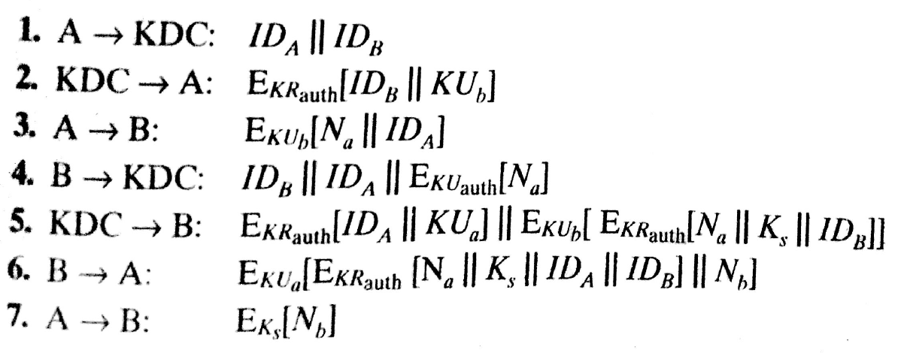
Woo’s AS protocol
This does not use timestamps.

Slide 17
One-Way Authentication
required when sender & receiver are not in communications at same time (eg. email)
Header should be in clear form to deliver the message by email system
Body of the message needs to be protected & sender needs to be authenticated
Notes:
One application for which encryption is growing in popularity is electronic mail (e-mail). The very nature of electronic mail, and its chief benefit, is that it is not necessary for the sender and receiver to be online at the same time. Instead, the e-mail message is forwarded to the receiver’s electronic mailbox,where it is buffered until the receiver is available to read it. The “envelope” or header of the e-mail message must be in the clear so that the message can be handled by the store-and-forward e-mail protocol. However it is often desirable that e-mail message be encrypted such that the mail-handling system is not in possession of the decryption key. A second requirement is that of authentication, where the recipient wants some assurance that the message is from the alleged sender. One-Way Authentication addresses these requirements.

Slide 18
Using Symmetric Encryption
Remove last two steps in Needham Schroeder authentication protocol and add message encrypted by session key.
1. A->KDC: ID_{A} || ID_{B} || N₁
2. KDC -> A: E_{Ka}[Ks || ID_{B} || N₁ || E_{Kb}[Ks||ID_{A}] ]
3. A -> B: E_{Kb}[Ks||ID_{A}] || E_{Ks}[M]
Vulnerable to replay attacks
could rely on timestamp in message, though email delays make this problematic
Notes:
Using symmetric encryption, with some refinement, the KDC strategy is a candidate for encrypted electronic mail. Because we wish to avoid requiring that the recipient be on line at the same time as the sender, steps 4 and 5 must be eliminated, leaving the protocol as shown.
This approach guarantees that only the intended recipient of a message will be able to read I, and also provides a level of authentication that the sender is A. As specified, the protocol does not protect against replays. You could rely on timestamp in the message, though email delays make this problematic.

Slide 19
Public-Key Approaches
if confidentiality is major concern, can use:
A->B: E_{PUb}[Ks] || E_{Ks}[M]
has encrypted session key, encrypted message
if authentication is needed, use a digital signature with a digital certificate:
A->B: M || E_{PRa}[H(M)] || E_{PRas}[T||ID_{A}||PU_{a}]
with message, signature, certificate
Notes:
Have already presented public-key encryption approaches that are suited to electronic mail, including the straight forward encryption of the entire message for confidentiality, authentication, or both. These approaches require that either the sender know the recipient’s public key (confidentiality) or the recipient know the sender’s public key (authentication) or both (confidentiality plus authentication). In addition, the public-key algorithm must be applied once or twice to what may be a long message.
If confidentiality is the primary concern, then the message can be encrypted with a one-time secret key, which in in turn is encrypted with B’s public key.
To achieve authentication, and to validate the senders public key, the signature can be encrypted with the recipient’s public key, and for assurance A’s public key is sent in a digital certificate, as shown. To obtain confidentiality as well, the message can be encrypted with a session key, combining both options above.

Slide 20
Digital Signature Standard (DSS)
US Govt approved signature scheme
designed by NIST & NSA in early 90's
published as FIPS-186 in 1991
revised in 1993, 1996 & then 2000
uses the SHA hash algorithm
DSS is the standard, DSA is the algorithm
FIPS 186-2 (2000) includes alternative RSA & elliptic curve signature variants
Notes:
DSA is the US Govt approved signature scheme, which is designed to provide strong signatures without allowing easy use for encryption. The DSS makes use of the Secure Hash Algorithm (SHA), and presents a new digital signature technique, the Digital Signature Algorithm (DSA). The DSS was originally proposed in 1991 and revised in 1993 in response to public feedback concerning the security of the scheme. There was a further minor revision in 1996. In 2000, an expanded version of the standard was issued as FIPS 186-2, which incorporates digital signature algorithms based on RSA and on elliptic curve cryptography.

Slide 21
Digital Signature Algorithm (DSA)
Used only for digital signature.
Can not be used for encryption / key exchange
security is based on difficulty of computing discrete logarithms
variant of ElGamal & Schnorr schemes
Faster than RSA
Notes:
Will discuss the original DSS algorithm. The DSA signature scheme has advantages, being both smaller (320 vs 1024bit) and faster (much of the computation is done modulo a 160 bit number), over RSA. Unlike RSA, it cannot be used for encryption or key exchange. Nevertheless, it is a public-key technique. The DSA is based on the difficulty of computing discrete logarithms, and is based on schemes originally presented by ElGamal [ELGA85] and Schnorr [SCHN91].

Slide 22
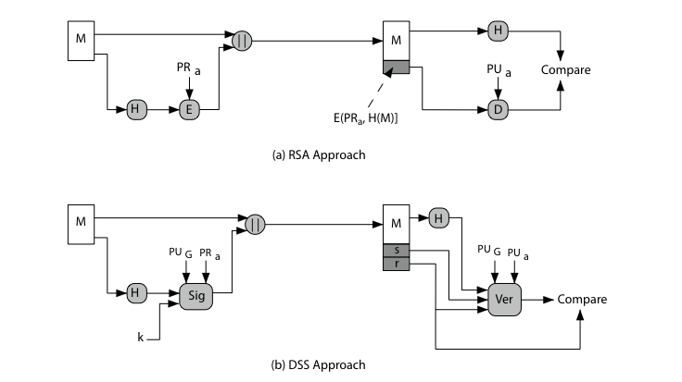
Digital Signature Algorithm (DSA)
Notes:
DSA differs from RSA in how the message signature is generated and validated, as shown in Stallings Figure 13.1.
RSA signatures encrypt the message hash with the private key to create a signature, which is then verified by being decrypted with the public key to compare to a recreated hash value.
DSA signatures use the message hash, global public values, private key & random k to create a 2 part signature (s,r). This is verified by computing a function of the message hash, public key, r and s, and comparing the result with r. The proof that this works is complex, but it achieves its aims!

Slide 23
DSA Key Generation
Global public key values (p,q,g) generation:
choose a prime p of size between 512 & 1024 bits.
choose another prime q of size 160 bits such that q is a divisor of p-1.
choose g of the form g=h^{(p-1)/q} mod p
where h is an integer; 1<h<p-1 and g > 1
User’s private & public key pair generation:
Choose a random no x <q (PVT Key)
compute y = g^{x} mod p (PUB key)
Note: Finding x from y is DLP
Notes:
DSA typically uses a common set of global parameters (p,q,g) for a community of clients, as shown. Then each DSA uses chooses a random private key x, and computes their public key as shown. The calculation of the public key y given x is relatively straightforward. However, given the public key y, it is computationally infeasible to determine x, which is the discrete logarithm of y to base g, mod p.

Slide 24
DSA Signature Creation
Let M be a message to be signed.
Sender generates a random no k, k<q
Note: k must be destroyed after use, and never be reused
then computes signature pair:
r = (g^{k} mod p)mod q
s = [k⁻¹(H(M)+ xr)] mod q
sends signature (r,s) with message M
Notes:
To create a signature, a user calculates two quantities, r and s, that are functions of the public key components (p,q,g), the user’s private key (x), the hash code of the message H(M), and an additional integer k that should be generated randomly or pseudo-randomly and be unique for each signing. This is similar to ElGamal signatures, with the use of a per message temporary signature key k, but doing calculations first mod p, then mod q to reduce the size of the result. The signature (r,s) is then sent with the message to the recipient. Note that computing r only involves calculation mod p and does not depend on message, hence can be done in advance. Similarly with randomly choosing k’s and computing their inverses.

Slide 25
DSA Signature Verification
having received M & signature (r,s)
to verify a signature, recipient computes:
w = s⁻¹ mod q
u1= [H(M)w ]mod q
u2= (rw)mod q
v = [(g^{u1} y^{u2})mod p ]mod q
if v=r then signature is verified
see book web site for details of proof.
Notes:
At the receiving end, verification is performed using the formulas shown. The receiver generates a quantity v that is a function of the public key components, the sender’s public key, and the hash of the incoming message. If this quantity matches the r component of the signature, then the signature is validated. Note that the difficulty of computing discrete logs is why it is infeasible for an opponent to recover k from r, or x from s. Note also that nearly all the calculations are mod q, and hence are much faster save for the last step.
The structure of this function is such that the receiver can recover r using the incoming message and signature, the public key of the user, and the global public key.I t is certainly not obvious that such a scheme would work. A proof is provided at this book’s Web site.

Slide 26
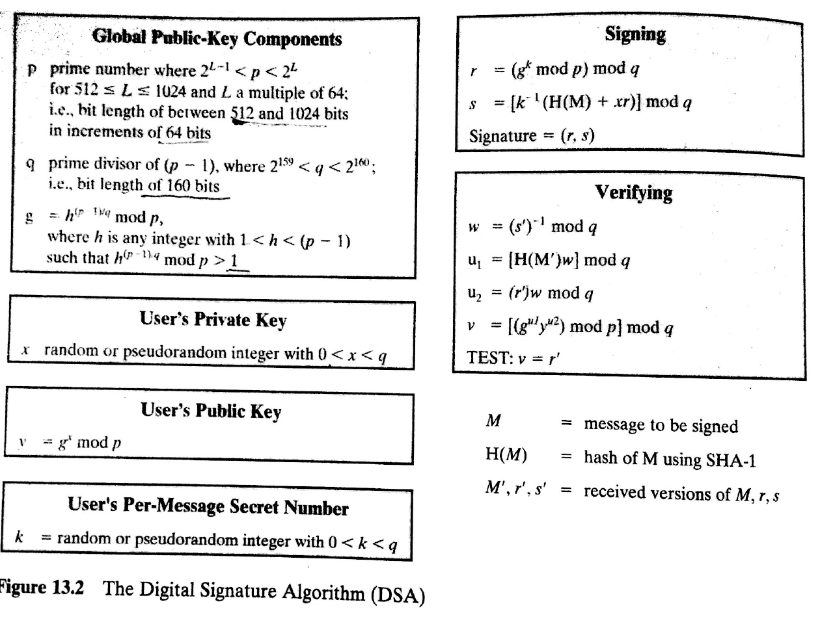

Slide 27
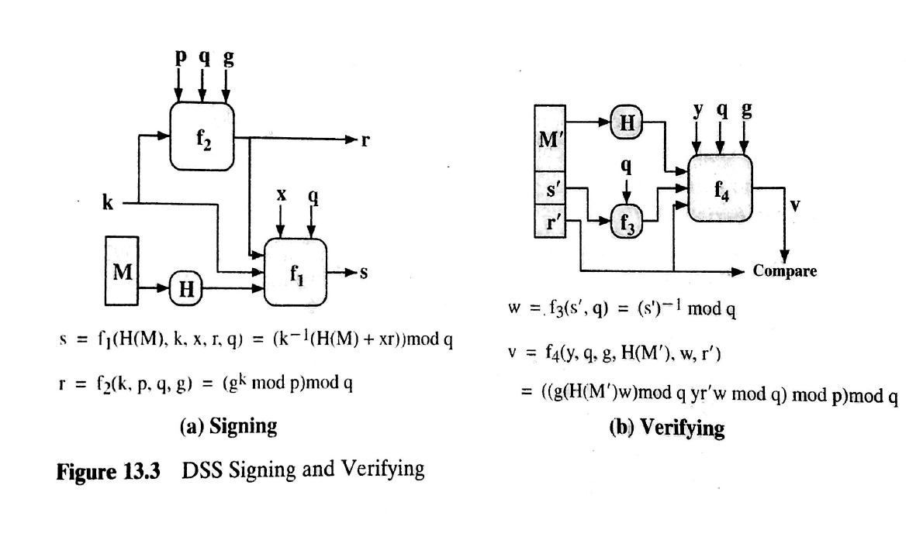

Slide 28
Summary
have discussed:
digital signatures
authentication protocols (mutual & one-way)
digital signature algorithm and standard
Notes:
Chapter 13 summary

